Slide 1
A brief introduction to Model-View-Controller architecture

Slide 2
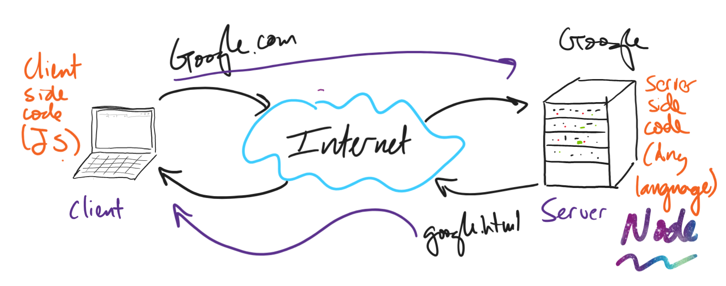
Context

Slide 3
We’ve been oversimplifying things…
Imagine if every possible webpage online was a static HTML page
We’d have to write an HTML file for:
Every possible email in Gmail
Every Amazon product with every review
Every possible Google Search result
Every possible IM on Instagram

Slide 4
We’ve been oversimplifying things…
Millions of pages would have to be hand-written every second
It would be impossible!
User privacy issues

Slide 5

Since webpages aren’t plain HTML files, what are they?
Web pages are created on the fly
Generally, web pages (and UIs) are broken into three parts:
Model: the data of a web page
View: the visual representation of the data
Controller: the behavior of the web page
https://en.wikipedia.org/wiki/Model%E2%80%93view%E2%80%93controller

Slide 6
Model-view-controller
Model
Data represented in a dedicated data structure
Examples:
Databases
Objects (e.g., JSON)
Tables (e.g., CSV, Excel)*
Just data. No visual or behavior
*please never do this.
https://en.wikipedia.org/wiki/Model%E2%80%93view%E2%80%93controller

Slide 7
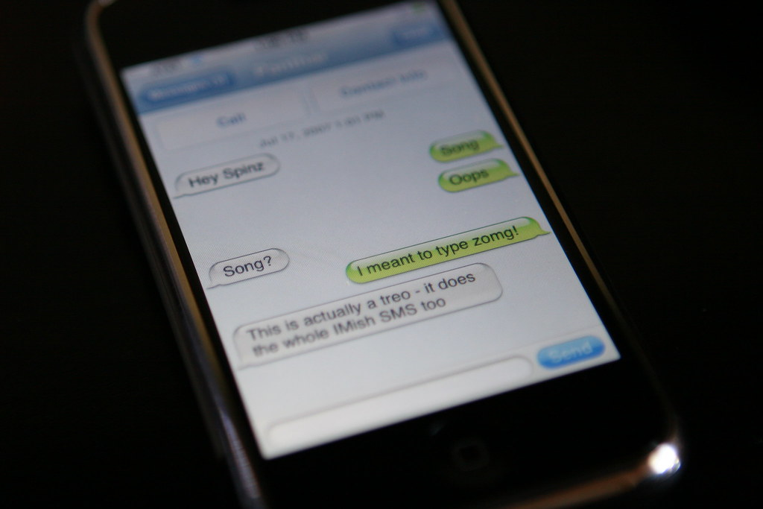
Model-view-controller
Model: Exercise
How could you represent the data of an simple instant messaging app in a tabular form?
https://www.flickr.com/photos/ericrice/840284432/

Slide 8
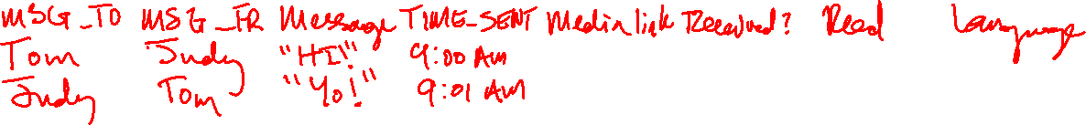
Model-view-controller
Model: Exercise
How could you represent the data of an simple instant messaging app in a tabular form?
https://www.flickr.com/photos/ericrice/840284432/

Slide 9
Model-view-controller
Generally, web pages are broken into three parts:
Model: the data of a web page
View: the visual representation of the data
Controller: the behavior of he web page
https://en.wikipedia.org/wiki/Model%E2%80%93view%E2%80%93controller

Slide 10
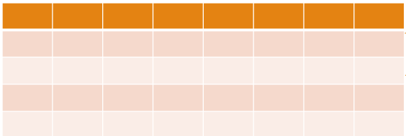
Model-view-controller
View
Provides the visual structure of the data in the model
Typically made up of:
HTML
CSS
A templating language
Just the visual structure. No behavioral logic
https://en.wikipedia.org/wiki/Model%E2%80%93view%E2%80%93controller

Slide 11
Model-view-controller
View
Provides the visual structure of the data in the model
Typically made up of:
HTML
CSS
A templating language
Just the visual structure. No behavioral logic
https://en.wikipedia.org/wiki/Model%E2%80%93view%E2%80%93controller

Slide 12
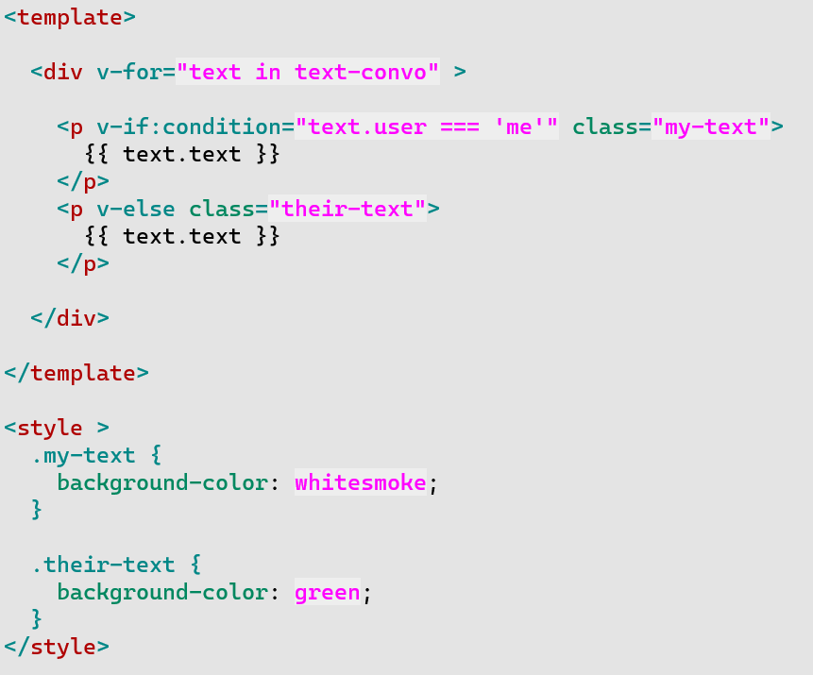
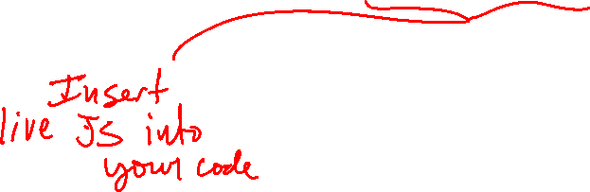

Model-view-controller
View: Example
This is how the Vue.js templating language iterates over a model*
text-convo model
time | user | text
1679248551 | them | Hey Spinz
1679248620 | me | Song
1679248891 | me | Oops
1679248109 | them | Song?
*this is oversimplified :)

Slide 13
Model-view-controller
Example
View: Your turn
Pair up to write templating pseudo-code for a Twitter-like tweet feed
time | user | tweet
1679212312 | codeKnight | Anyone going to the concert?
1679212320 | HTMLBuff333 | I just refactored some awful HTML for this guy name Leroy
1679212323 | CSSYeti | I need a burrito.
1679212333 | AdaStarGazrs | Check out my sweet new website bit.ly/alkefjalwkjfaw
⋮ | ⋮ | ⋮

Slide 14
Model-view-controller
View: Example
This is how the Vue.js templating language iterates over a model*
text-convo model
time | user | text
1679248551 | them | Hey Spinz
1679248620 | me | Song
1679248891 | me | Oops
1679248109 | them | Song?
What happens when you hit this button?
*this is oversimplified :)

Slide 15
Model-view-controller
Generally, web pages are broken into three parts:
Model: the data of a web page
View: the visual representation of the data
Controller: the behavior of he web page
https://en.wikipedia.org/wiki/Model%E2%80%93view%E2%80%93controller

Slide 16
Model-view-controller
Controller: how the user manipulates the data model through the view
https://en.wikipedia.org/wiki/Model%E2%80%93view%E2%80%93controller

Slide 17

Model-view-controller
Controller: how the user manipulates the data model through the view
User clicks “Send”
https://en.wikipedia.org/wiki/Model%E2%80%93view%E2%80%93controller

Slide 18
Model-view-controller
Controller: how the user manipulates the data model through the view
User clicks “Send”
Since the text field is blank…
the controller will not update the message table
Sets an error flag in the model
https://en.wikipedia.org/wiki/Model%E2%80%93view%E2%80%93controller

Slide 19
Model-view-controller
Controller: how the user manipulates the data model through the view
Error flag is set
https://en.wikipedia.org/wiki/Model%E2%80%93view%E2%80%93controller

Slide 20
Model-view-controller
Controller: how the user manipulates the data model through the view
Update the view with the flag
Enter text, please!
https://en.wikipedia.org/wiki/Model%E2%80%93view%E2%80%93controller

Slide 21
Model-view-controller
Controller: how the user manipulates the data model through the view
Enter text, please!
Zomg I love texting
User enters “zomg I love texting” and hits “send”
https://en.wikipedia.org/wiki/Model%E2%80%93view%E2%80%93controller

Slide 22
Model-view-controller
Controller: how the user manipulates the data model through the view
Controller
clears the error flag in model
Updates the model to include new text
Enter text, please!
Zomg I love texting
https://en.wikipedia.org/wiki/Model%E2%80%93view%E2%80%93controller

Slide 23
Model-view-controller
Controller: how the user manipulates the data model through the view
Model is updated by controller
Enter text, please!
Zomg I love texting
https://en.wikipedia.org/wiki/Model%E2%80%93view%E2%80%93controller

Slide 24
Model-view-controller
Controller: how the user manipulates the data model through the view
View is updated to remove error message and the new text
Zomg I love texting
https://en.wikipedia.org/wiki/Model%E2%80%93view%E2%80%93controller

Slide 25


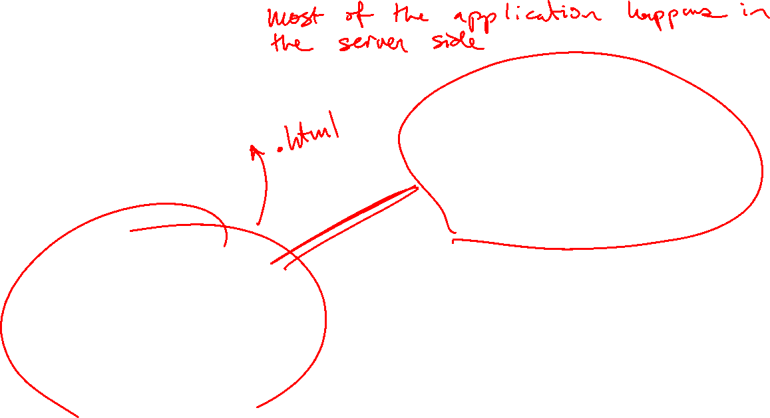
Model-view-controller on real websites: Thin client
Client
Server

Slide 26
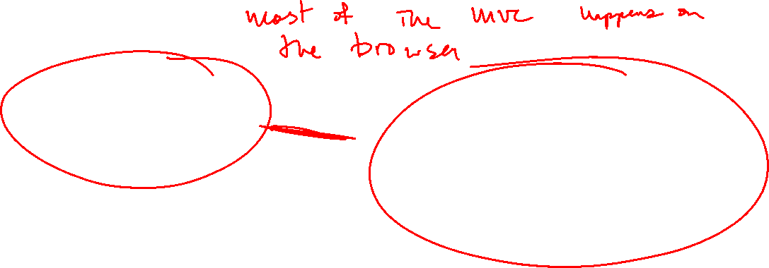
Model-view-controller on real websites: Thick client
Client
Server

Slide 27
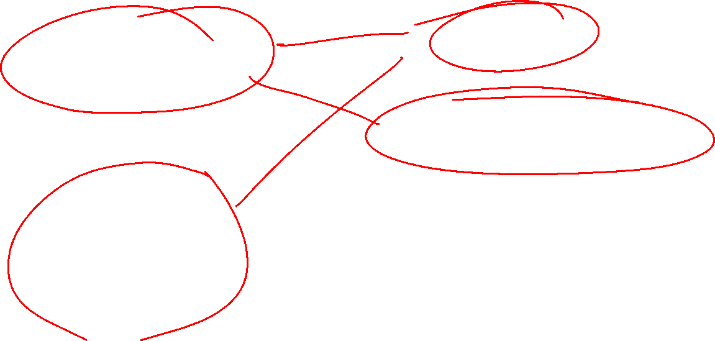
Model-view-controller on real websites: Mixtures
Client
Server

